Slide 1


Compressed EWK study(ISRC1N2)
Department of Physics, Shandong University
Chengxin Liao
liaocx@ihep.ac.cn
Apr, Thu 17, 2025

Slide 2
Tasklist
FF method var distribution check
Multiclass result(failed)
BSc thesis: https://www.overleaf.com/project/674e7119837a2580151a0868 (need to submit before the end of Apr)
Chengxin Liao
IHEP SUSY Meeting

Slide 3
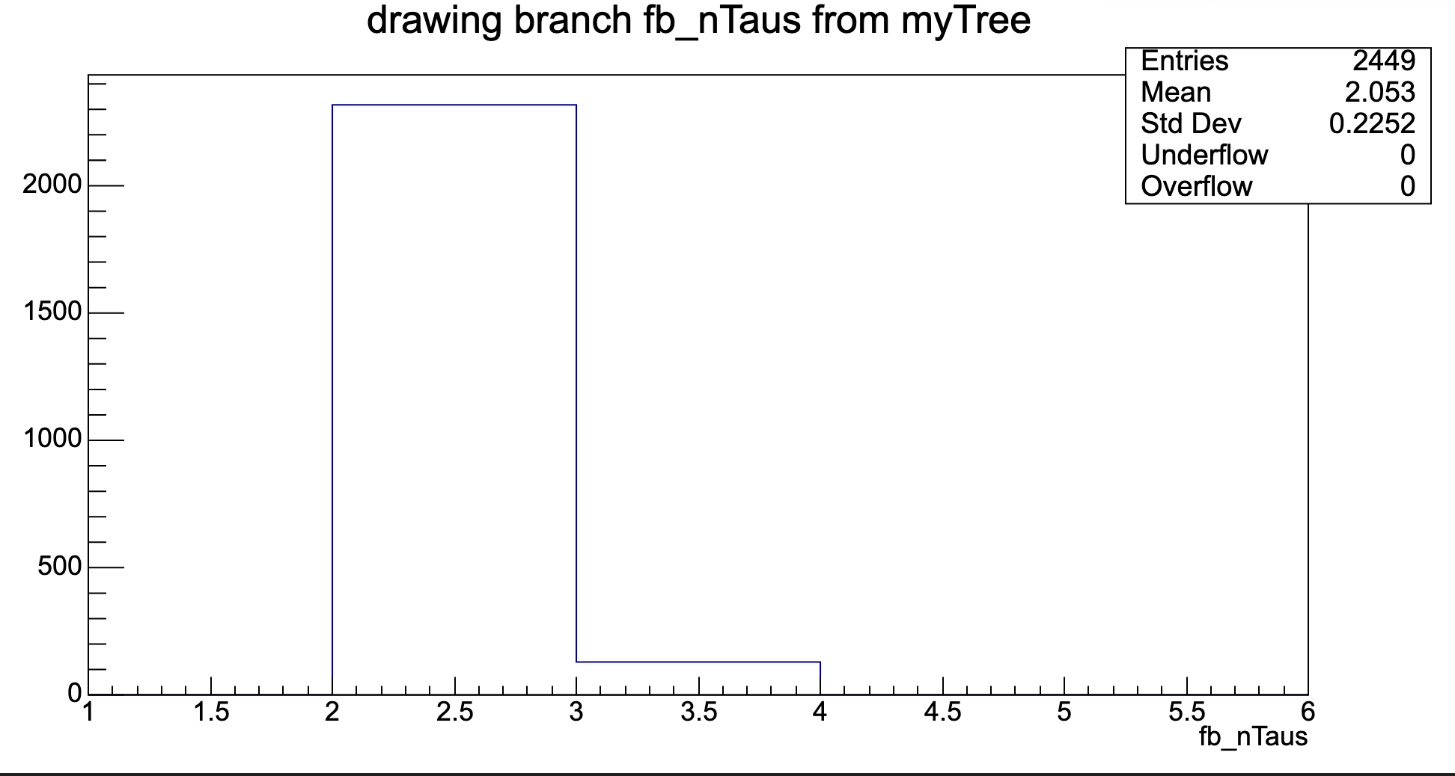
FF method
Should change to >= ?
Pre-Selection
SR(2ID):
nBaseTau == 2, medium tau == 2 nBaseLeps == 0
nBaseJets >= 1 MET trigger & MET >= 200 OS bVeto Mtt_reco <=40 && Mtt_reco >= 130
CR(ID): nBaseTau == 1, medium tau == 1
nBaseLeps >= 1 OS MET trigger & MET >= 200
bVeto
For HH signal
1
Chengxin Liao
IHEP SUSY Meeting

Slide 4
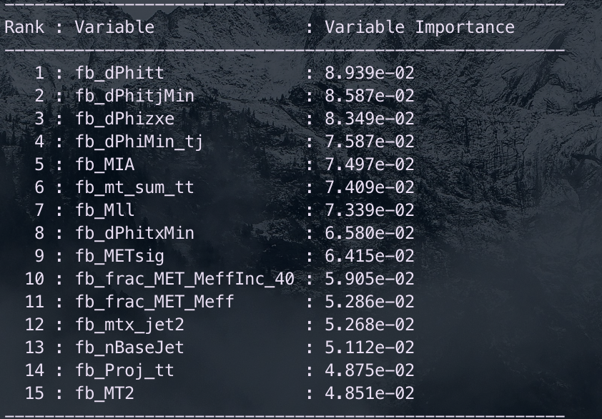
Multiclass(HH)
Hyperparameters: Ntrees = 200, MaxDepth = 6, MinNodeSize = 2%, Learning rate = 0.03(initial setting)
Feature engineering: Select a simple model and put all features into model, choose Top 30 vars based on importance list, drop high correlated vars Final feature list:
Split strategy: Separate entries by using mod 5, for Fake bkg, if separate follow sequence, all weighted entry will split into first fold
Chengxin Liao
IHEP SUSY Meeting

Slide 5
Multiclass(HH)
Class: C1N2, VV, Other_bkg
Hyperparameter tune: use optuna to auto-optimze
Test_auc = \sum{Test_auc_class} Train_auc = \sum{Train_auc_class}
constraint: average of AUC need to >= 0.6 penalty function: score = test_auc – 0.3*auc_gap (auc_gap = abs(train_auc- test_auc)) maximum(score)
After check some models, find C1N2 result is great, so the constraint and AUC calculation only in VV and Other bkg
Grid Search Ntrees: [200, 300, 400]
MaxDepth: [4, 6, 8, 10] MinNode: [1, 3, 5, 7]
Learning rate: [0.001, 0.01, 0.1]
Best one: Ntree=300, MaxDepth=8, MinNode=1%, Learning Rate=0.1
Chengxin Liao
IHEP SUSY Meeting

Slide 6
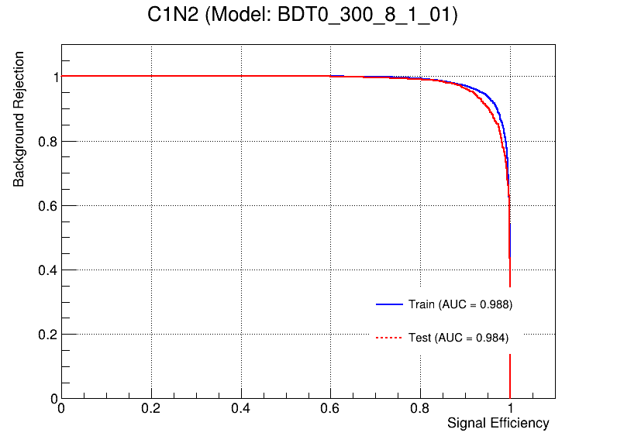
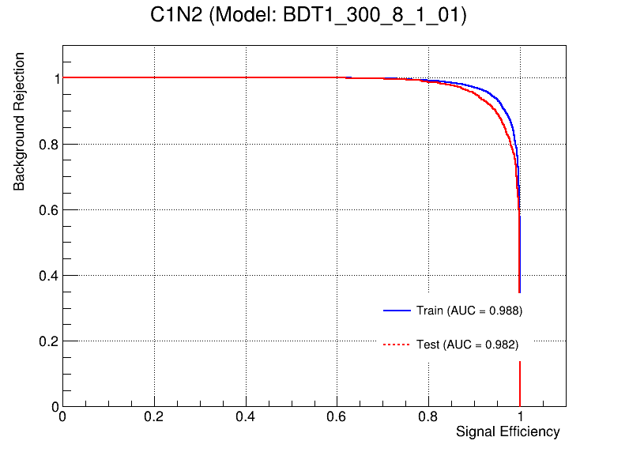
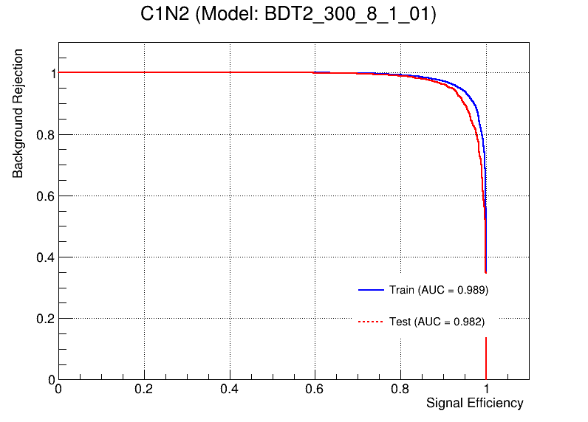
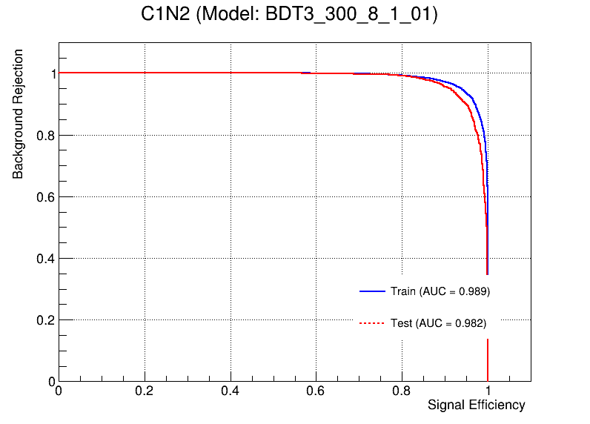

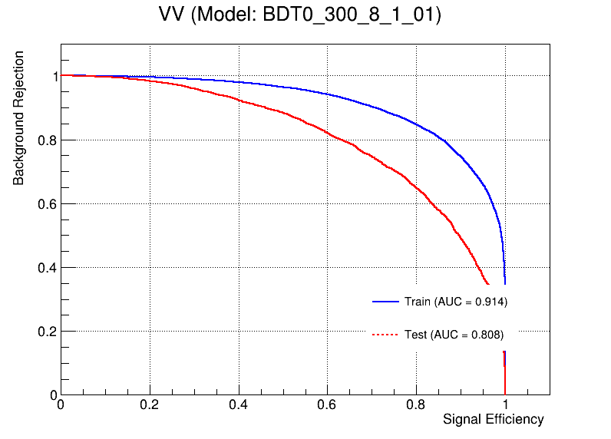
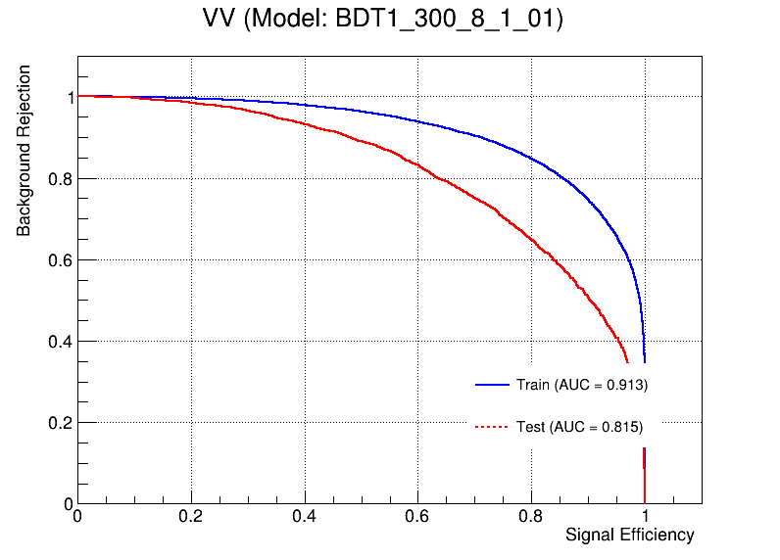

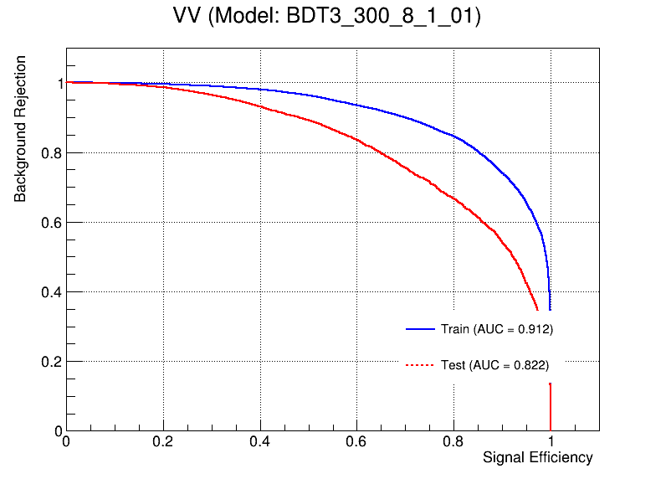

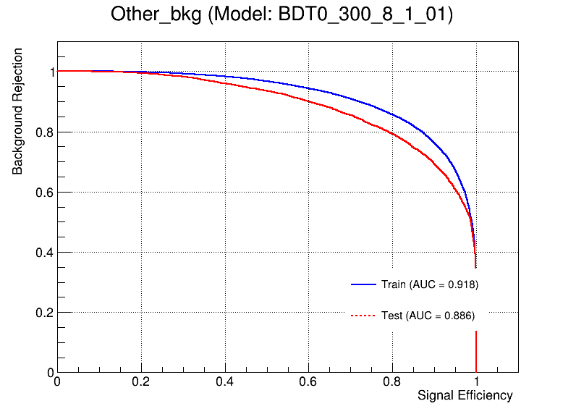


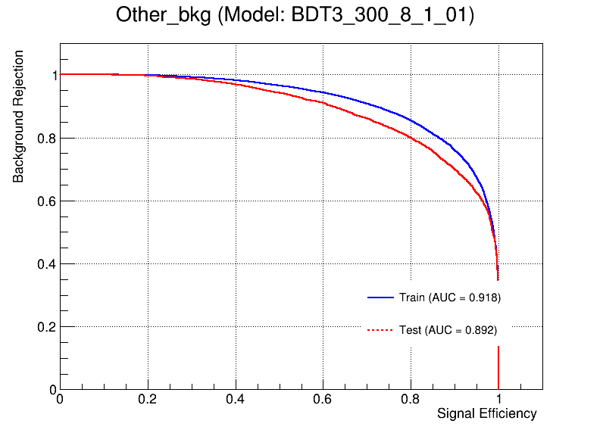
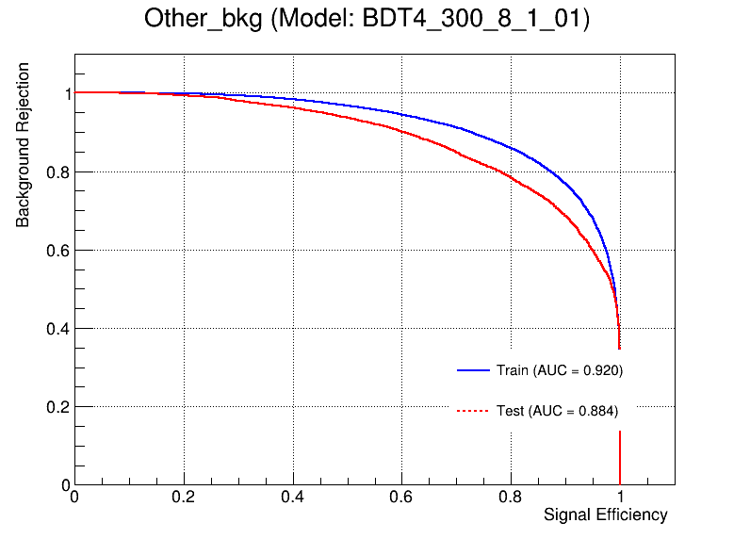
Multiclass(HH)
OverFit Check
Chengxin Liao
IHEP SUSY Meeting

Slide 7
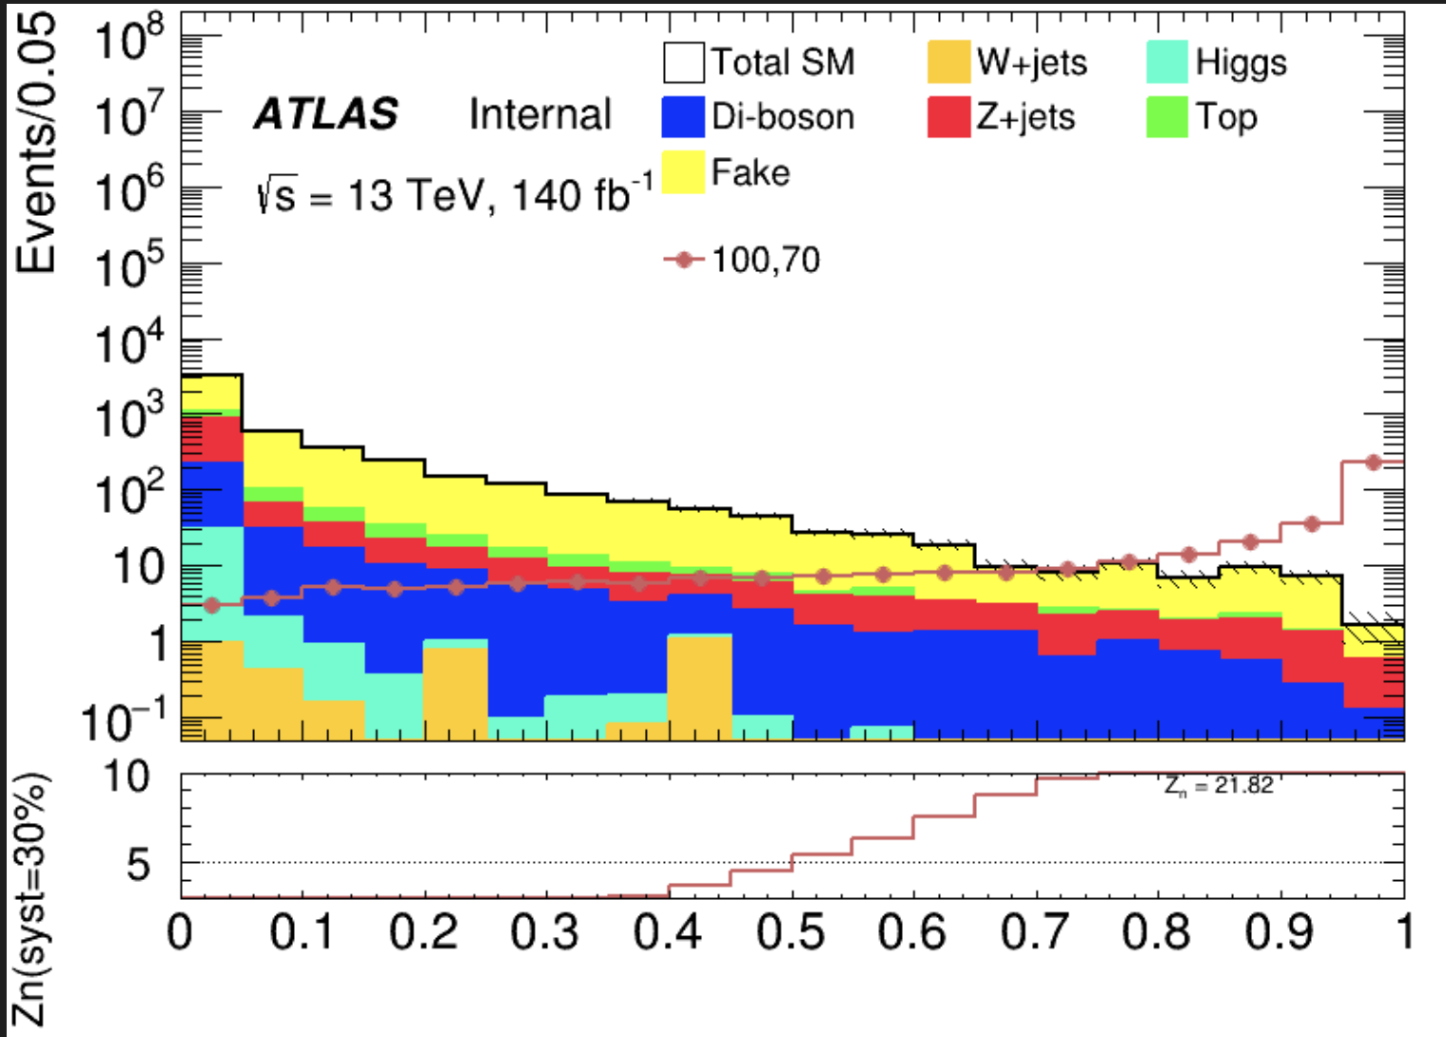
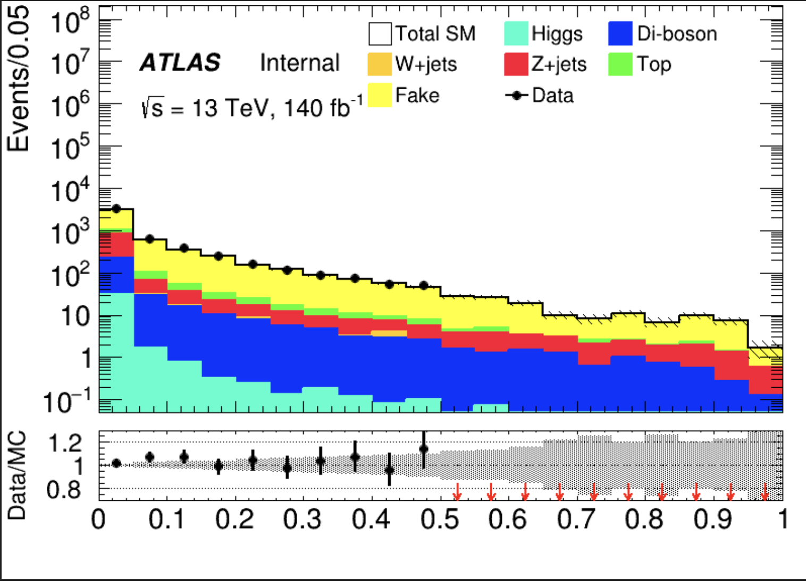
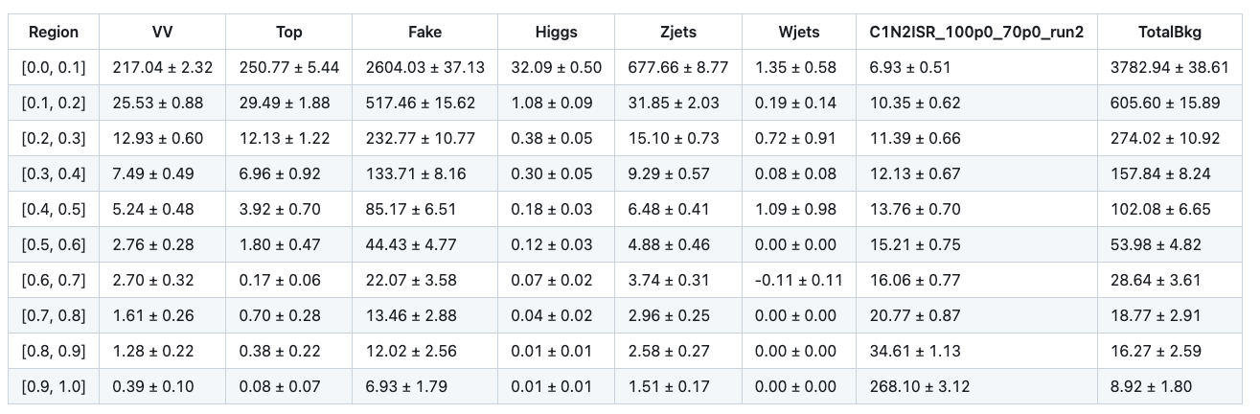
SR
Blind data >= 0.5
Lumi label is wrong, it should be 193.4
1
Chengxin Liao
IHEP SUSY Meeting

Slide 8
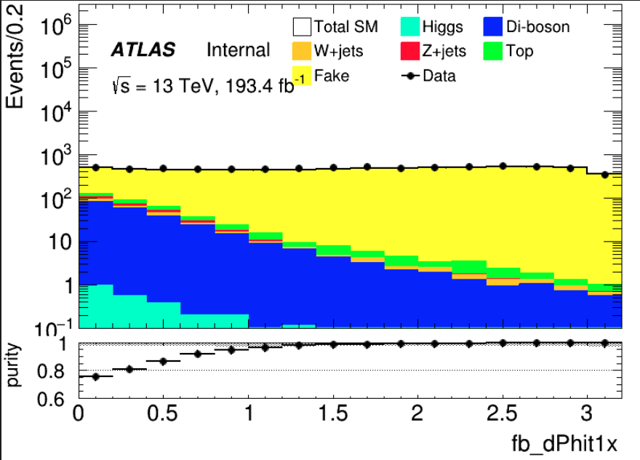
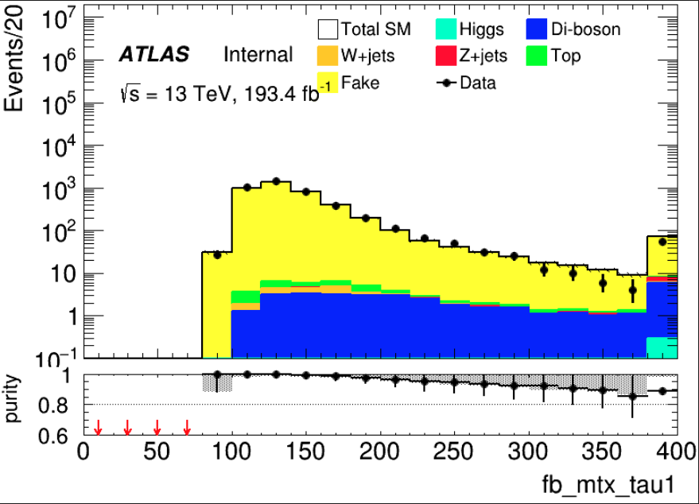
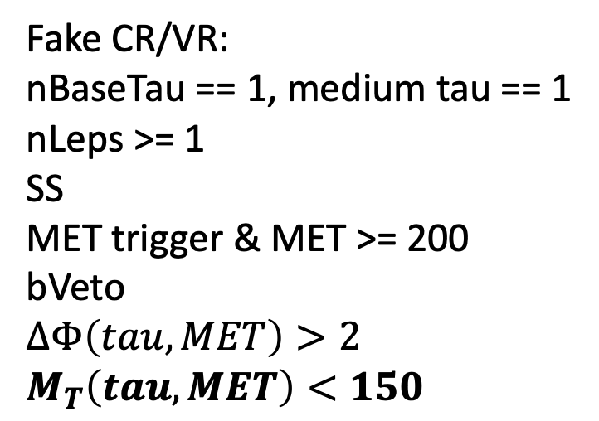
fake
TotalBkg | Fake | purity | Data | Data/Bkg
2891.87+-34.3311 | 2878.83+-34.3195 | 0.995491 | 2916 | 1.00864
Fake CR/VR: nBaseTau == 1, medium tau == 1
nLeps >= 1 SS MET trigger & MET >= 200
bVeto $$∆Φ\left(tau, MET\right)>2 \\ M_{T}\left(tau, MET\right)<150$$
Orthogonal with LH SR
Change that to BDT score
2
Chengxin Liao
IHEP SUSY Meeting

Slide 9
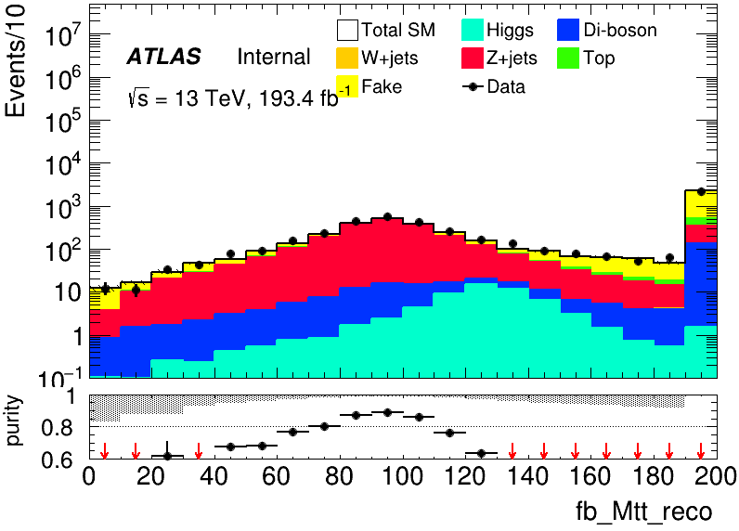
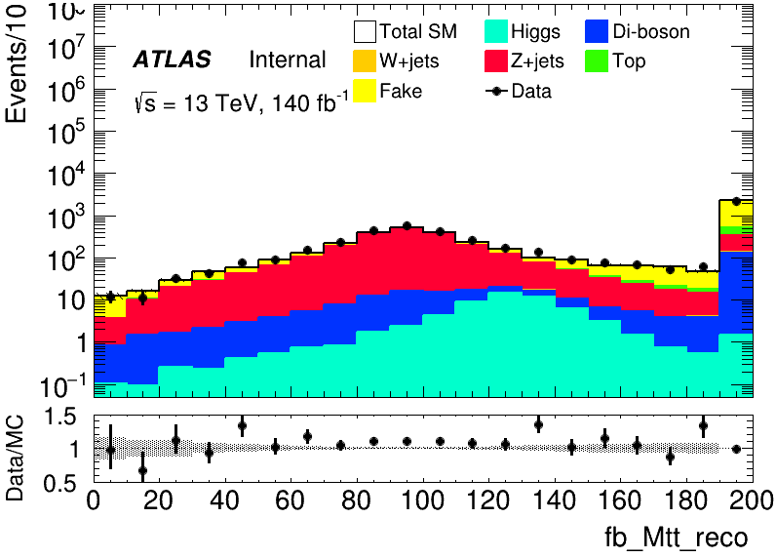
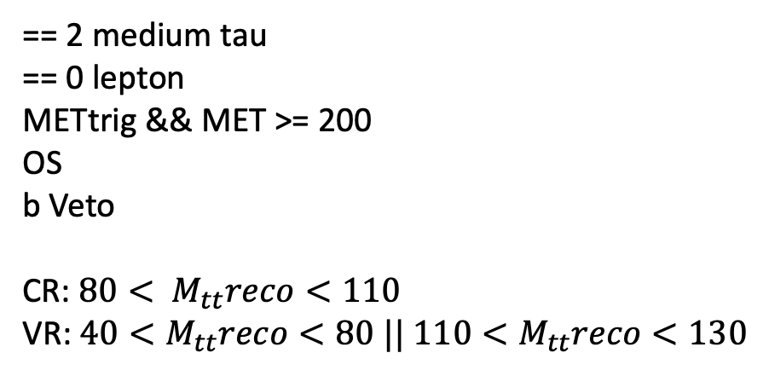
Zjets
== 2 medium tau == 0 lepton METtrig && MET >= 200 OS b Veto CR: $80< M_{tt}reco<110$ VR: $40<M_{tt}reco<80 || 110<M_{tt}reco<130$
Region | TotalBkg | Zjets | purity | Data | Data/Bkg
CR | 1296.91 | 1132.62+-5.33999 | 0.873322 | 1438 | 1.04934
VR | 895.804 | 659.573+-4.16375 | 0.736292 | 978 | 1.05085
3
Chengxin Liao
IHEP SUSY Meeting

Slide 10
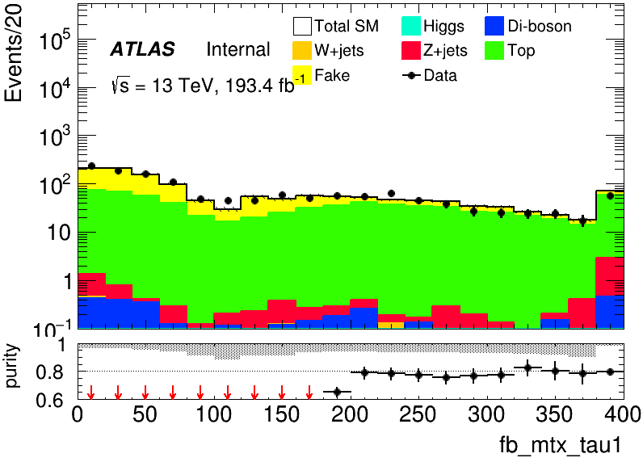
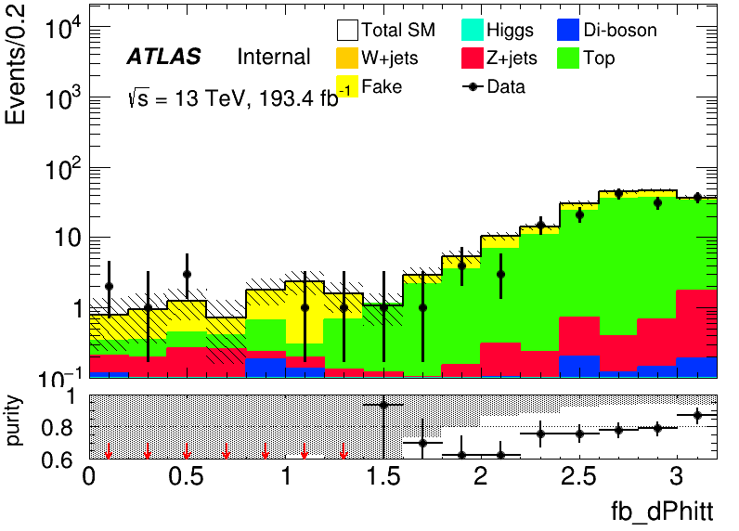
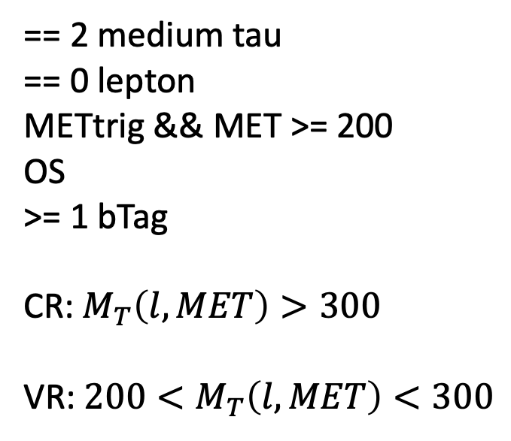
Top
== 2 medium tau == 0 lepton METtrig && MET >= 200 OS >= 1 bTag CR: $M_{T}\left(l,MET\right)>300$ VR: $200<M_{T}\left(l, MET\right)<300$
Region | TotalBkg | Top | purity | Data | Data/Bkg
CR | 171.478+-5.3865 | 136.178+-3.88968 | 0.794142 | 1438 | 0.8538
VR | 313.202+-7.84499 | 171.478+-5.3865 | 0.731 | 314 | 1.00255
4
Chengxin Liao
IHEP SUSY Meeting

Slide 11
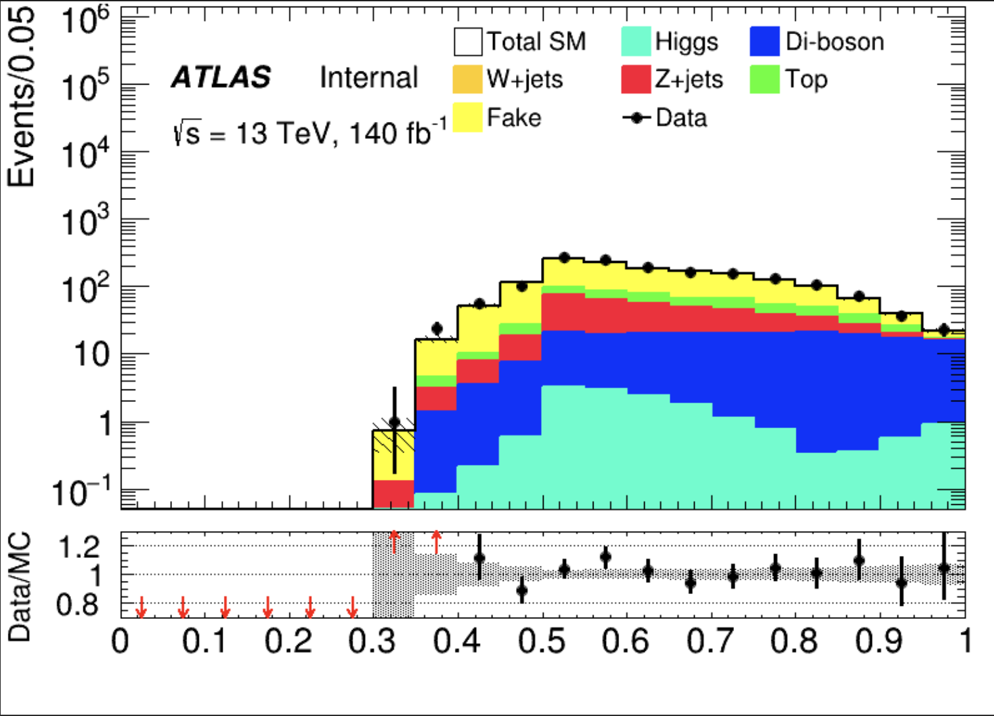
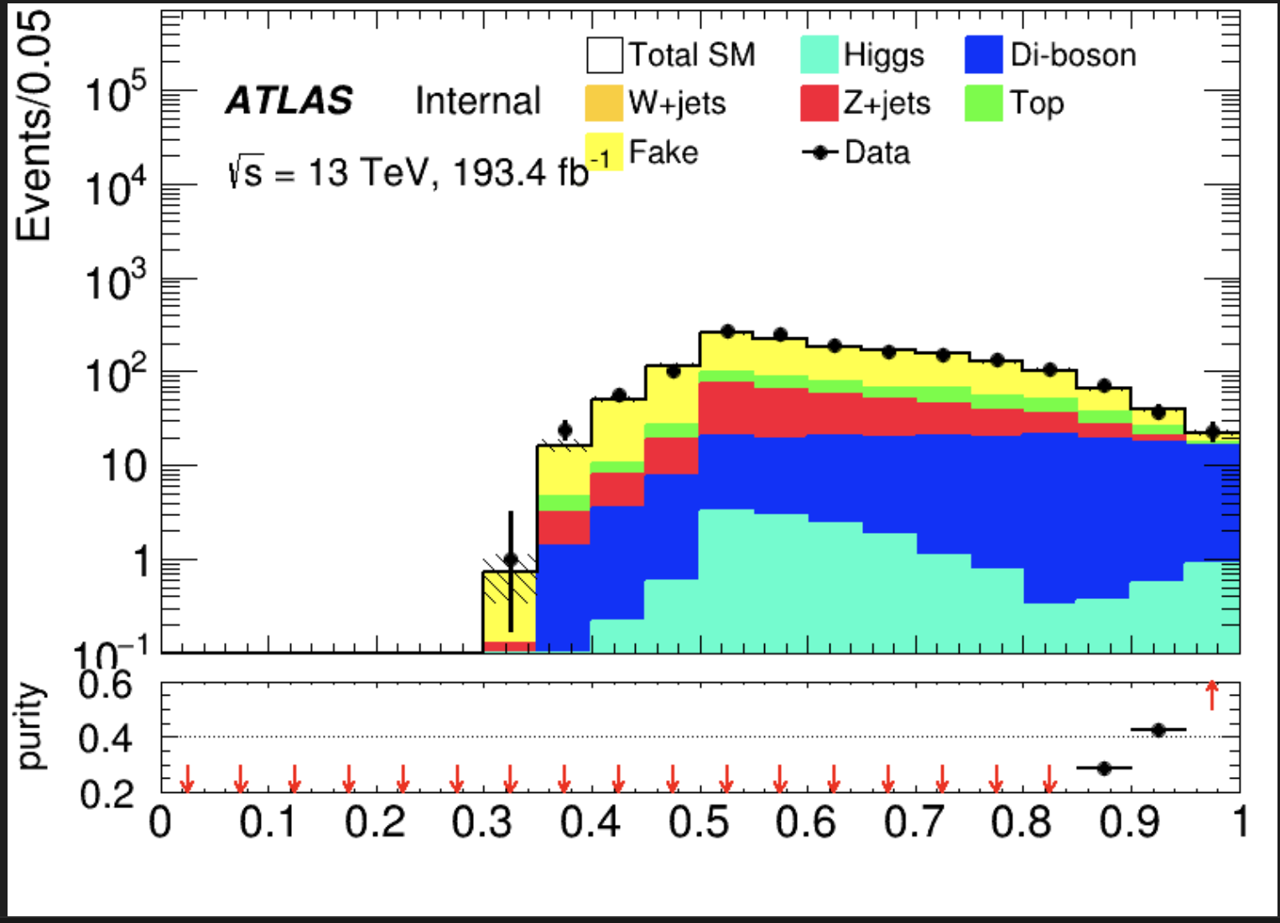
VV
C1N2_score <= 0.7 && Max(score) == VV_score && VV_score >= 0.90
Region | TotalBkg | VV | purity | Data | Data/Bkg
VR | 61.3683+-2.9461 | 31.7024 | 0.516593 | 60 | 0.9777
1
Chengxin Liao
IHEP SUSY Meeting

Slide 12
Backup

Slide 13
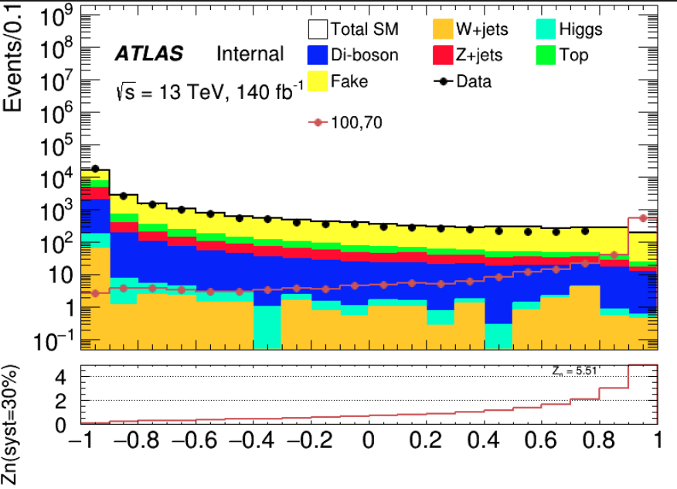
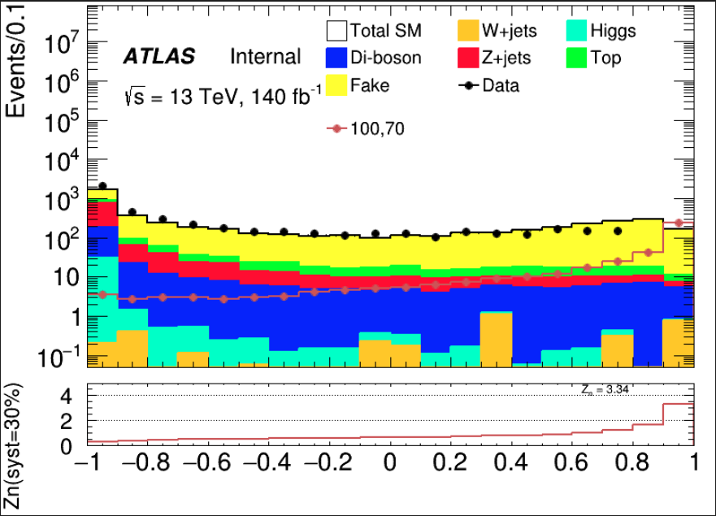
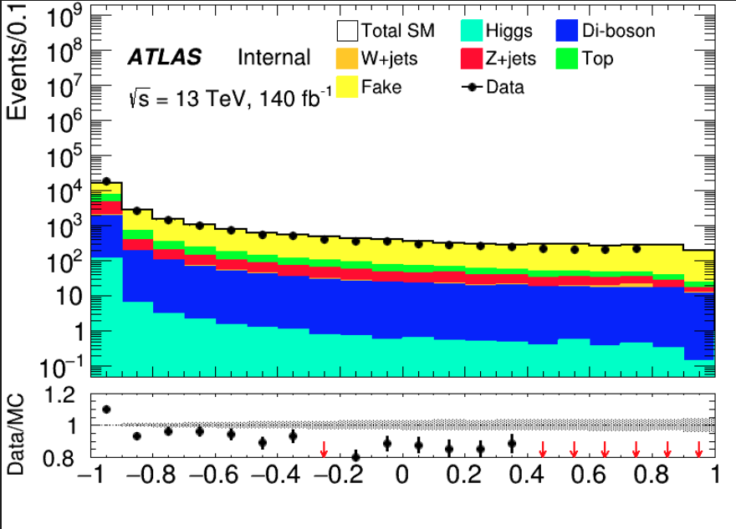
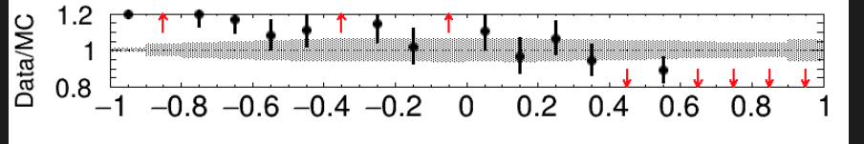
SR
HH channel
LH channel
1
Chengxin Liao
IHEP SUSY Meeting

Slide 14
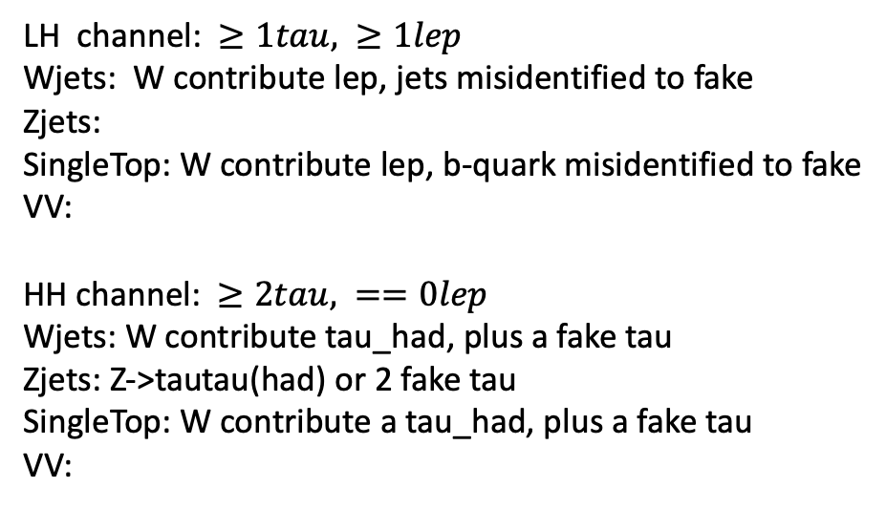
Bkg decay mode
LH channel: $≥1tau, ≥1lep$ Wjets: W contribute lep, jets misidentified to fake Zjets:
SingleTop: W contribute lep, b-quark misidentified to fake
VV: HH channel: $≥2tau, ==0lep$ Wjets: W contribute tau_had, plus a fake tau Zjets: Z->tautau(had) or 2 fake tau SingleTop: W contribute a tau_had, plus a fake tau VV:
Wjets: W->e/muon + nu W->tau+nu(can contribute true tau_had) jet misidentified to a fake tau Zjets: Z->ll/tautau jet misindentified to fake tau Top: top->W+b, W can contribute a true tau_had b-quark is a source of fake VV: W/Z
Chengxin Liao
IHEP SUSY Meeting

